Slide 1




An introduction to R and Rstudio
Joost Raeymaekers
Faculty of Biosciences and Aquaculture, Nord University, Bodø, Norway
@JoostRaeymkrs
Notes:
This is the lecture on Introduction to R and Rstudio.

Slide 2
An introduction to R and Rstudio
Notes:
Imagine you are a researcher for the government, a scientist working at a company, or a thesis student working on a bachelor, master or phd thesis. You have collected a lot of data on an important subject in the biosciences. This could be as variable as the molecular processes that are activated within a single cell, or the species interactions witihin an entire ecosystem. Such data will almost always be complex, and therefore we need appropriate statistical tools to summarize and visualise a lot of relevant information. This is exactly what R and Rstudio provide. For instance, this multiplot made with R reveals the most important patterns that can be derived from such a large database. This is extremely helpful to support scientific conclusions and decision making.

Slide 3
What are R and Rstudio?
R is an open-source statistical software package, developed, maintained, and distributed by the «R community ». It is free for download. All functionality within R is based on bioinformatic coding with the R language.
Rstudio has been developed as a user interface for R. It is also free for download. It makes R more user-friendly (= easier to overview and organize projects, develop and execute R code, and install additional features).
https://www.r-project.org/
https://www.rstudio.com/
Notes:
So, what are R and Rstudio? R is an open-source statistical software package, developed, maintained, and distributed by the «R community ». It is free for download. All functionality within R is based on bioinformatic coding with the R language. Rstudio has been developed as a user interface for R. It is also free for download. It makes R more user-friendly (this means: easy to overview and organize projects, easier to develop and execute R code, and easy to install additional features). I recommend that you visit these two webpages.

Slide 4

Why do we need R and Rstudio?
Data scientists regard R (and Rstudio) as a great tool, for several reasons:
R makes it much easier to manage large projects and databases, organize statistical analyses, generate and save results, create figures, and overview many project files. Moreover, R has excellent graphical output.
All-in-One: thanks to the possibility to install additional «packages » ( = libraries of R code with specific functionalities), R can be used for all kinds of purposes and applications in the biosciences. It can deal with any type of data (numerical, categorical, DNA sequence data, species counts).
Data analysis and project management in R is equivalent to, or better than, commercial statistical software (SAS, SPSS, STATISTICA), and in any case superior to spreadsheet applications such as Excel.
Since R is based on bioinformatic coding, it is much safer to manage large datasets (including sorting, splitting and merging datasets)
Notes:
Data scientists regard R (and Rstudio) as a great tool, for several reasons:
R makes it much easier to manage large projects and databases, organize statistical analyses, generate and save results, create figures, and overview many project files. Moreover, R has excellent graphical output.
All-in-One: thanks to the possibility to install additional «packages » ( = libraries of R code with specific functionalities), R can be used for all for all kinds of purposes and applications in the biosciences. It can deal with any type of data (numerical, categorical, DNA sequence data, species counts).
Data analysis and project management in R is equivalent to, or better than, commercial statistical software (SAS, SPSS, STATISTICA), and in any case superior to spreadsheet applications such as Excel.
Since R is based on bioinformatic coding, it is much safer to manage large datasets (including sorting, splitting and merging datasets)

Slide 5
Why do we need R and Rstudio?
R has a steep learning curve - comparable to learning a new language.
However, with relatively little knowledge about R, you will be able to do a lot of useful stuff.
Once you get used to R, you likely don’t need any other statistical software for your bachelor, master or doctoral studies.
P.S: An alternative to R/Rstudio could be Python. R/Rstudio is more used by researchers for data exploration and statistics, while Python is more used by programmers. For a full comparison, check https://www.datacamp.com/community/tutorials/r-or-python-for-data-analysis
Notes:
R/Rstudio has a steep learning curve - comparable to learning a new language.
However, with relatively little knowledge about R, you will be able to do a lot of useful stuff. We all know that with a few words in a foreign language, you can already do important stuff, such as ordering a beer or two (In english: two beers please! In spanish: dos cervezas por favor! In Dutch: twee pintjes alstublieft! In french: deux bières s-il-vous plait! In German: Zwei bier bitte!). It works the same in R.
Once you get used to R, you likely don’t need any other statistical software for your bachelor, master or doctoral studies.

Slide 6
Today’s purpose
How to install R and Rstudio
R file types
How to launch Rstudio
How to use Rstudio
The R language
How to overview files and results in R
R packages («libraries»)
How to maintain R/Rstudio
Finding help with R
Notes:
Today’s purpose
How to install R and Rstudio
R/Rstudio file types
How to launch R/Rstudio
How to use R/Rstudio
Some basics of the R language
R packages («libraries»)
How to maintain R/Rstudio
Finding help with R

Slide 7
How to install R and Rstudio?
R: surf to https://cran.uib.no/
For Windows users: Click «Download R for Windows», «Install R for the first time», and «Download R X.X.X for Windows». Then download and execute the application file "R-X.X.X-win.exe".
For Mac users: Click «Download R for (Mac) OS X». Then download and execute the application file "R-X.X.X.pkg".
Rstudio: surf to https://www.rstudio.com/products/rstudio/download/#download
For Windows users: save and install "RStudio-X.X.XXX.exe“
For Mac users: save and install "Rstudio-X.X.XXX.dmg"

Slide 8
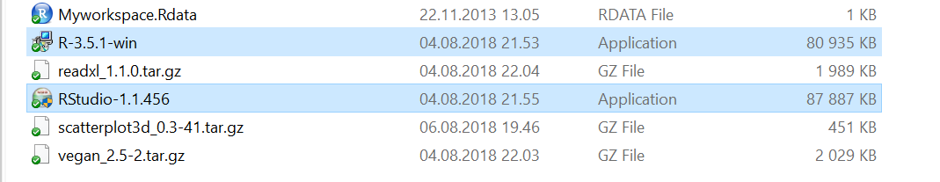
How to install R and Rstudio?
Rstudio depends on R. So, it is very important to first install application 1 (R), and only then application 2 (Rstudio)
1
2
Help with installation
For Windows users:
https://www.freestatistics.org/cran/bin/windows/base/rw-FAQ.html
For Mac users:
https://www.freestatistics.org/cran/bin/macosx/RMacOSX-FAQ.html

Slide 9
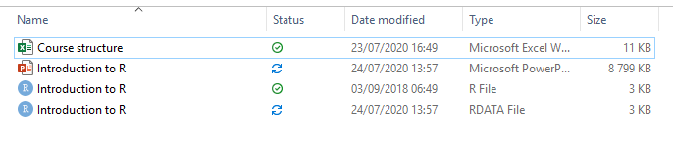
R/Rstudio: 2 types of files
Files with extension «.R» (aka ”R scripts”): text files with command lines. A single file can contain a few to more than 1000 lines of code.
Example: «Introduction to R.R»
Files with extension «.Rdata» (aka ”R workspace files”): files which contain objects generated by R such as vectors with numbers, functions, data bases, ... A single file can contain multiple objects, but can also be empty.
Example: «Introduction to R.Rdata»
Note the difference in file format!
To make your life easy, make sure to associate both file types automatically with Rstudio
Notes:
R and Rstudio work with two types of files: files with extension dot R, and files with extension dot Rdata.

Slide 10
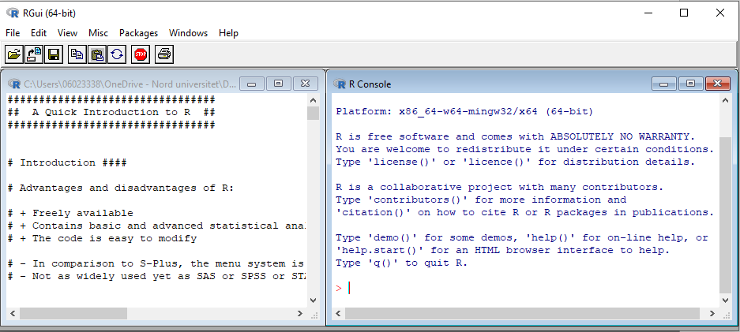
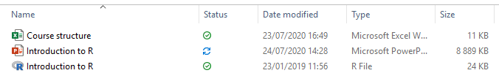
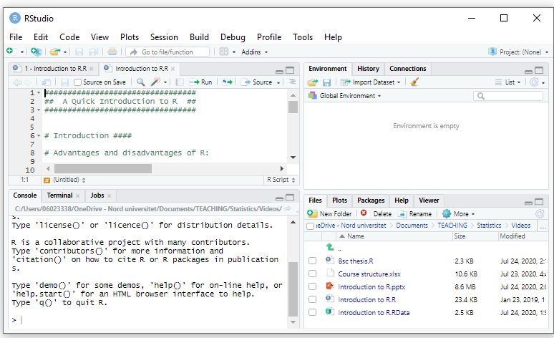
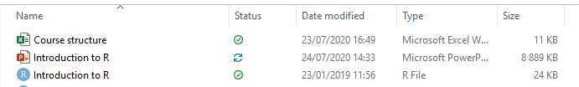
R/Rstudio: 2 types of files
When you see the symbol in front of an «.R» or «.Rdata» file, than the file is associated with R. Double-clicking the file will open the file in R instead of Rstudio.
When you see the symbol in front of an «.R» or «.Rdata» file, than the file is associated with Rstudio. Double-clicking the file will open the file in Rstudio instead of R. This is the preferred option as Rstudio is more user-friendly than R.

Slide 11
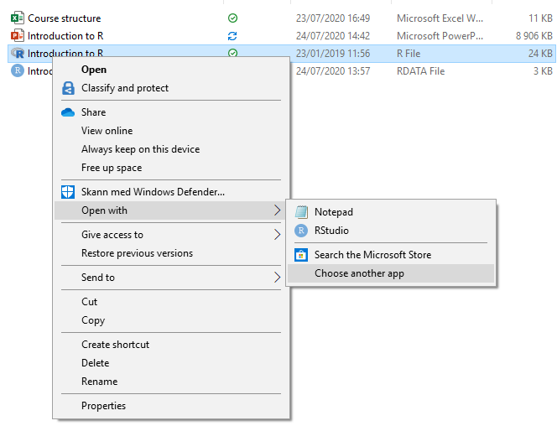
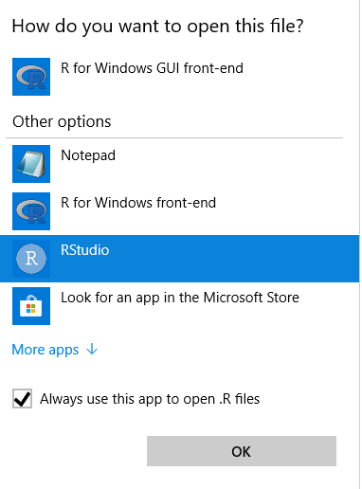
R/Rstudio: 2 types of files
In order to always open «.R» files and «.Rdata» files with Rstudio, right-click the file and choose «Open With». Then select «Choose another app» and choose Rstudio. Do not forget to tick the box «Always use this app to open .R files» or «Always use this app to open .Rdata files».

Slide 12
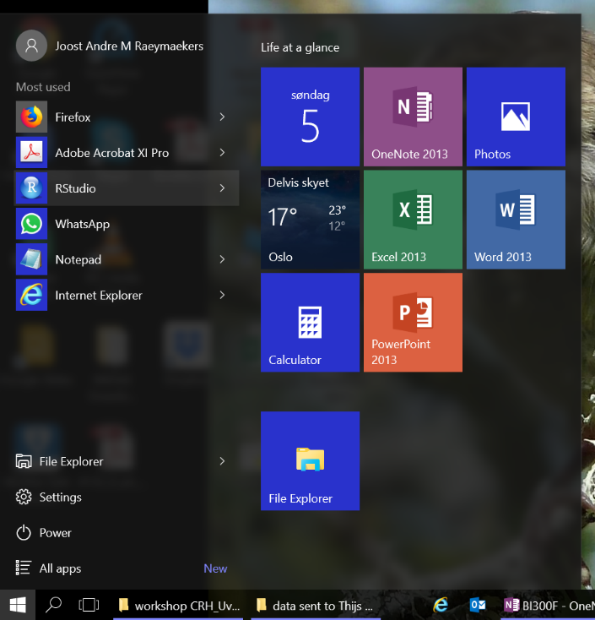
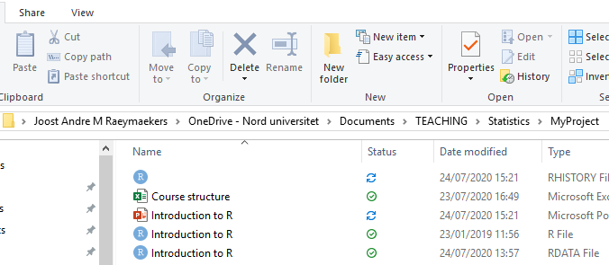
How to launch Rstudio? (Windows)
You only have to launch Rstudio, since it communicates with R in the background.
Method A: Start > Rstudio
Method B (recommended):
Start > File Explorer
Browse to your project folder or to your course folder
Open Rstudio by double-clicking a file with extension « .R » or «.Rdata»
The first time you do this, remember to right-click and choose Rstudio as the default application to open «.R» and «.Rdata» files (see slide 11).

Slide 13
How to launch Rstudio? (Windows)
You only have to launch Rstudio, since it communicates with R in the background.
Method A: Start > Rstudio
Method B (recommended):
Start > File Explorer
Browse to your project folder or to your course folder
Open Rstudio by double-clicking a file with extension « .R » or «.Rdata»
Important feature of R and Rstudio: the software always looks for files in a specific working directory (= a specific physical space (folder) on your computer).
If you open Rstudio with method A:
Rstudio chooses a default working directory
Rstudio will not automatically find the files you need
If you open RStudio with method B:
Rstudio chooses the folder from which you launched Rstudio as the working directory.
Rstudio will automatically find the files in this folder
It is crucial to know which folder you want to set as your working directory
Be aware that method A and B choose a different working directory
Method B allows you to set the right working directory from the start. This makes it easy to keep track of your project files while using R/Rstudio.
13

Slide 14
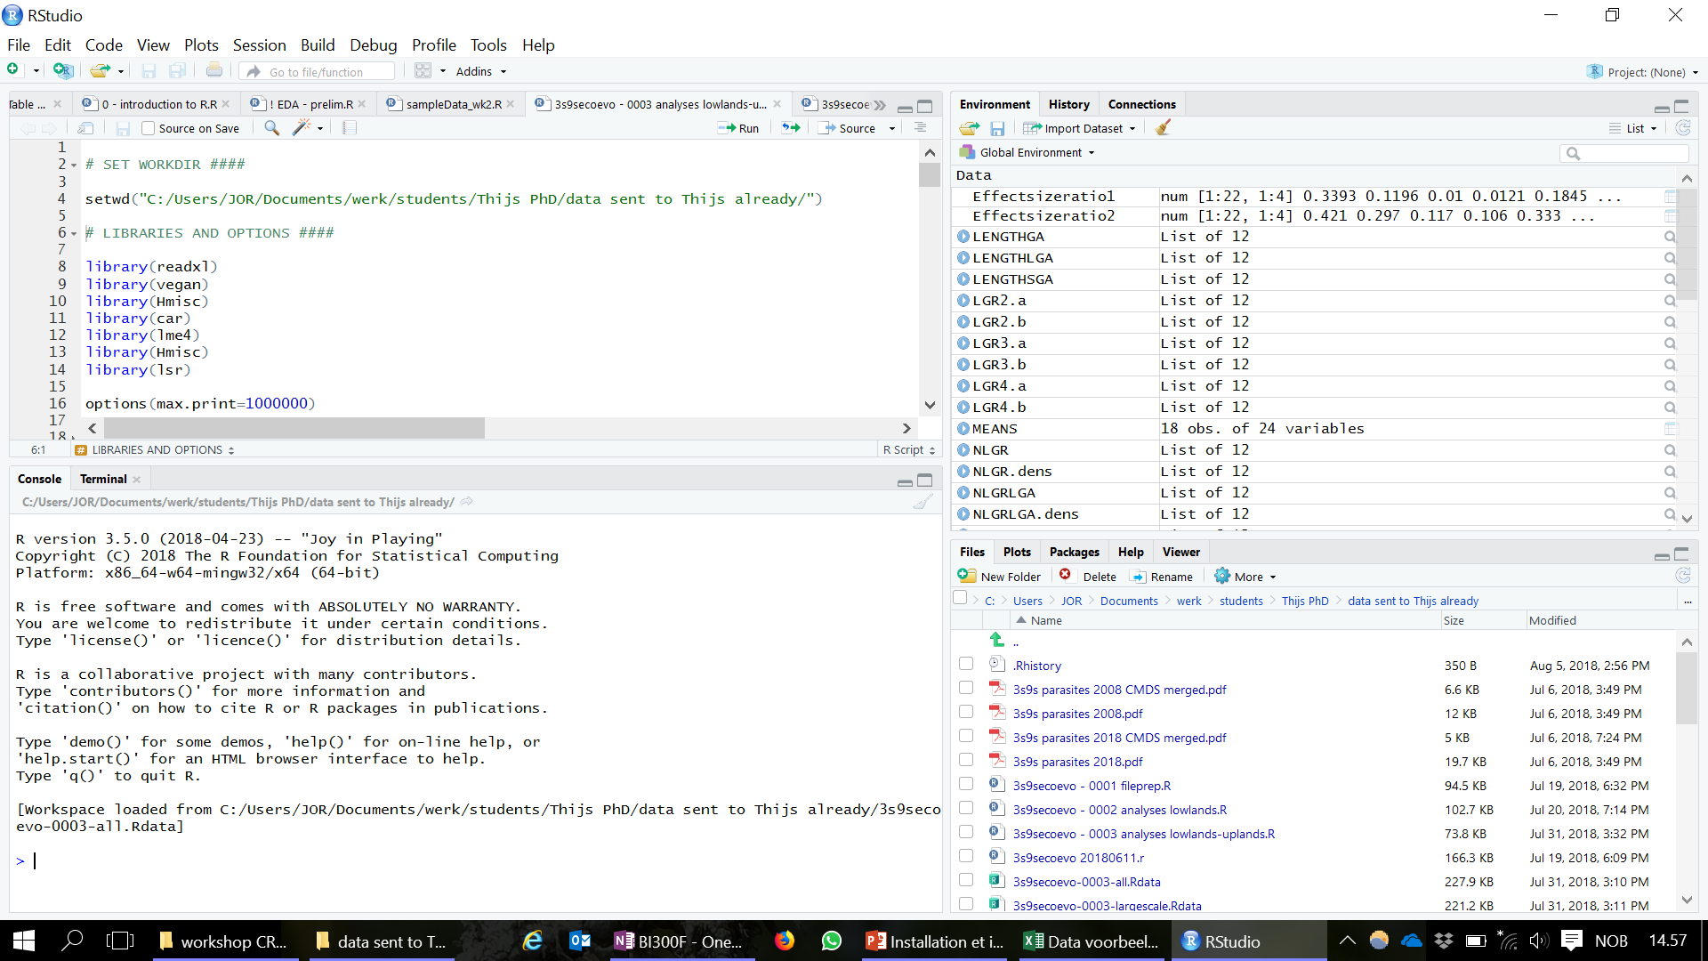
How to use Rstudio?
The 4 windows of Rstudio:
Editor: code/commands/script
Workspace (+history)
Here you do all the scripting and you can send commands to the Console
Here you find a list of all the objects in the active workspace (variables, functions, vectors, data, ...)
Console: computing
Files/plots/packages/help
Here you get results and error messages. You can also enter commands line by line.
Overview of files in your working directory, figures, packages and help
(Note: if you launch R instead of Rstudio, you only get an editor and console window)

Slide 15
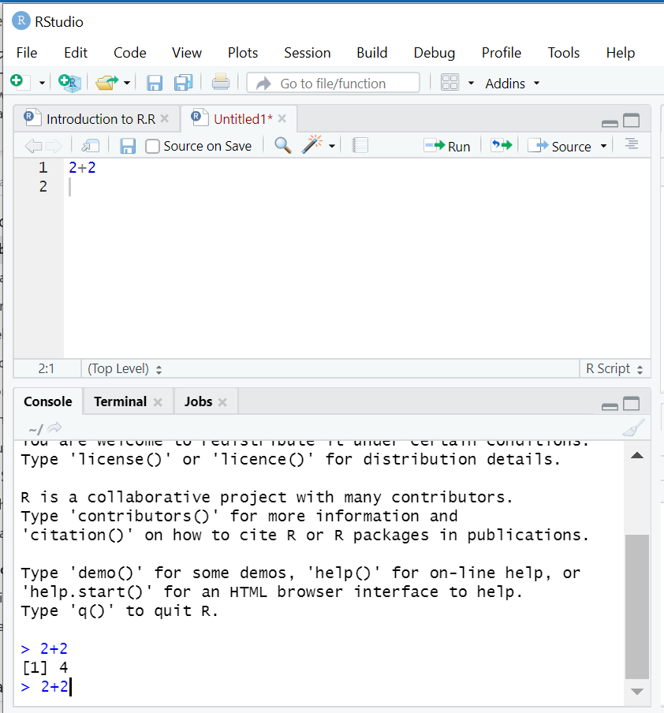
How to use Rstudio?
What is the difference between the Editor and Console window?
The ‘Editor’ allows you to write scripts, save & open scripts, and execute scripts using Ctrl+R
e.g.: type in 2+2 and press ‘Ctrl+R’
The code will be sent to the Console, and the outcome of the code/calculation (if any) will appear on the next line.
The ‘Console’ is your computing environment.
e.g.: type in 2+2 and press ‘enter’
The outcome of the code/calculation (if any) will appear on the next line.

Slide 16
It is very important to remember that (1):
How to use Rstudio?
… In the «Editor» window, you can enter and save all your scripts. So, the editor window just works like a text editor. The line numbers in the margin are useful, because scripts can become very long.
In the «Console» window, you can enter and execute code directly. HOWEVER, after you close Rstudio, the console will be erased, and all the code you have entered in this window will be lost.

Slide 17
It is very important to remember that (2):
How to use Rstudio?
So, in order to save your work, always use the editor window. To save your script, choose «File > Save as», and save the script as an .R file. As long as you haven’t saved your script, it will appear in red. In this example, the name of the unsaved script is «Untitled1».
Use the console window only if you want to test something quickly.

Slide 18
By the way …
How to use Rstudio?
You can work with multiple scripts simultaneously (in this example, two different script files are opened). This is useful in case you want to do different analyses on the same data.
In the console window, you can use your keyboard arrows (↑or ↓) to re-run some code. This will save you some time with typing. However, it only remembers the recent history, and all your work in this window is lost once you close Rstudio.

Slide 19
The R language
R/Rstudio works with code and simple functions, such as to calculate the mean or the standard deviation:
> mean(c(5,4,3))
[1] 4
> sd(c(5,4,9,2,1,1,1,0,3,4,5,6,12))
[1] 3.451124
It is also possible to store these calculations as simple objects. You can do so using the assignment operator "<-":
> A <- mean(c(5,4,3))
> B <- sd(c(5,4,9,2,1,1,1,0,3,4,5,6,12))
> A
[1] 4
> B
[1] 3.451124
Pay attention to the difference!
> mean(c(5,4,3)) # returns the outcome directly
[1] 4
> A <- mean(c(5,4,3)) # stores the outcome as object “A”

Slide 20
The R language
Storing calculations as objects in the memory of the R programme has the advantage that you can use them later for more advanced calculations:
> A <- mean(c(5,4,3))
> B <- sd(c(5,4,9,2,1,1,1,0,3,4,5,6,12))
> A
[1] 4
> B
[1] 3.451124
> A*B
[1] 13.8045

Slide 21
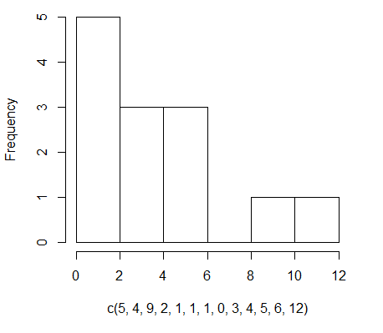
The R language
Some functions in R/Rstudio are developed to return graphical output. An example is the function hist() which returns a histogram:
> hist(c(5,4,9,2,1,1,1,0,3,4,5,6,12))
Also the output of the hist() function can be stored as an object for later use. The output of the hist() function is stored as a list with 6 slots ($):
> C <- hist(c(5,4,9,2,1,1,1,0,3,4,5,6,12))
> C
$breaks
[1] 0 2 4 6 8 10 12
$counts
[1] 5 3 3 0 1 1
$density
[1] 0.19230769 0.11538462 0.11538462 0.00000000 0.03846154 0.03846154
$mids
[1] 1 3 5 7 9 11
$xname
[1] "c(5, 4, 9, 2, 1, 1, 1, 0, 3, 4, 5, 6, 12)"
$equidist
[1] TRUE attr(,"class") [1] "histogram"

Slide 22
The R language
In addition to built-in functions such as mean(), sd() and hist(), it is also possible to create your own functions. Those new functions can again be stored as objects for more advanced calculations later on:
> MyNewFunction <- function(x) {y <- 4*x; y}
> MyNewFunction(4)
[1] 16
> MyNewFunction(-0.75)
[1] -3
> MyNewFunction(-0.75)*MyNewFunction(4)
[1] -48

Slide 23
The R language
Importantly, the R language is object-oriented, which means it is sensitive to spelling and capitals:
> ValueA <- 4 # With this you tell R that ValueA is equal (“<-”) to 4
> valueA
Error: object 'valueA' not found
> ValueA # Capitals are important! We defined ValueA, not valueA
[1] 4

Slide 24
The R language
To wrap up this quick introduction to the R language, the above examples illustrate that a single line of code does one of the following:
It directly returns the output of a calculation:
> mean(c(5,4,ValueA))
[1] 4.333333
2) It generates a graph:
> hist(c(5,4,9,2,1,1,1,0,3,4,5,6,12))
3) It adds an object ( = a value, a list, a function, …) to your workspace :
> ValueB <- 9*8
> C <- hist(c(5,4,9,2,1,1,1,0,3,4,5,6,12))
> MyNewFunction <- function(x) {y <- 4*x; y}
4) It returns an error message:
> mean(c(5,4,valueA))
Error in mean(c(5, 4, valueA)) : object 'valueA' not found

Slide 25
Overviewing files and results in R
… Or how to not get confused.
Overviewing files and results in R is not difficult, but likely a bit confusing at the beginning.
You need to understand:
Where R objects are stored
How you can save R objects in a «.Rdata» (workspace) file
How you can export figures
How you can save R scripts in an «.R» file
How you can find and change your working directory

Slide 26
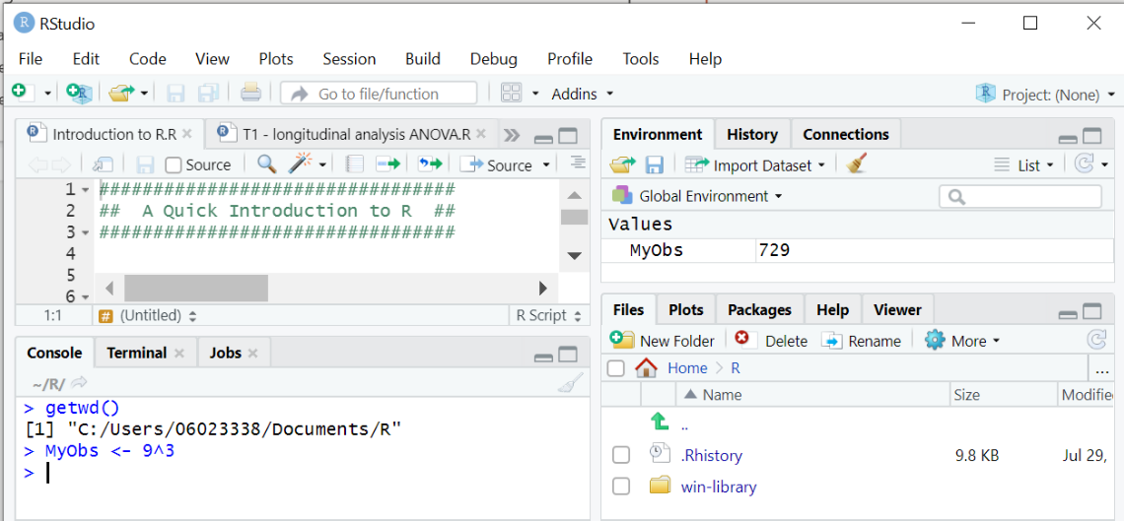
Overviewing files and results in R
1. Where does R store objects?
Every time you use the assignment operator "<-", R saves an object. Where is this object stored?
2) The object appears in your workspace
1) The object is defined in the Console using "<-"
3) The object does NOT appear in the working directory
The Console is your computing environment. R code is sent from the Editor or entered directly. The Console processes the code, and stores any newly defined object in the workspace.

Slide 27
Overviewing files and results in R
1. Where does R store objects?
Every time you use the assignment operator "<-", R saves an object. Where is this object stored?
2) The object appears in your workspace
1) The object is defined in the Console using "<-"
3) The object does NOT appear in the working directory
Objects stored in the workspace are in your computer’s memory, and are NOT automatically saved in your working directory! Therefore all objects will be deleted when you close your workspace without saving it.

Slide 28
Overviewing files and results in R
2. How can I save R objects?
All objects can be saved in a workspace file (“.Rdata” file). To save your workspace (including all objects such as values, lists, functions, …), click the “save” icon under the “Environment” tab.

Slide 29
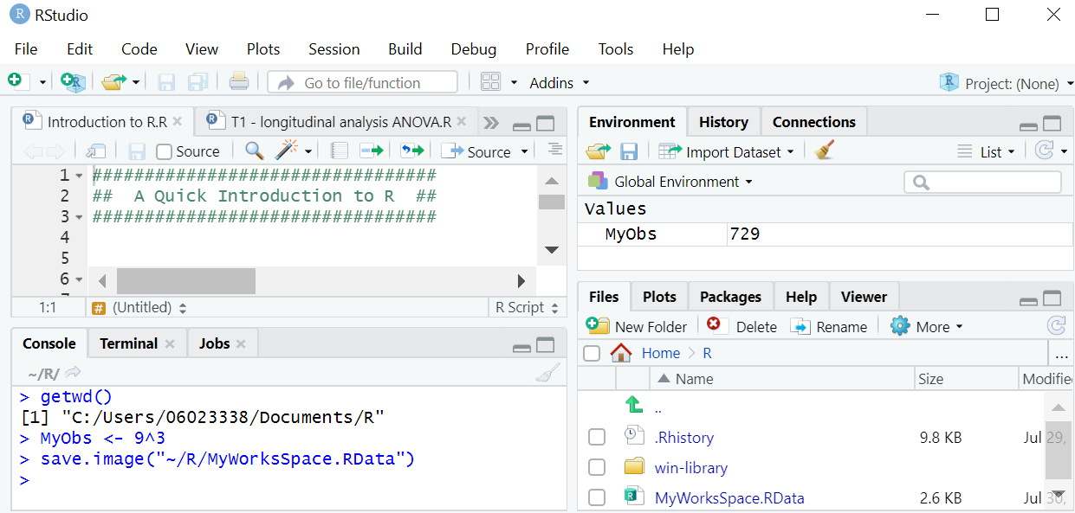
Overviewing files and results in R
2. How can I save R objects?
After saving, the workspace is available as an .Rdata file in your working directory, and you can now safely close Rstudio. On the next session, just double-click this .Rdata file and you can continue your work where you left.
Unless you are satistfied with all the analyses in your script, and are ready to summarize the results in a report, there is not really a need to do this.

Slide 30
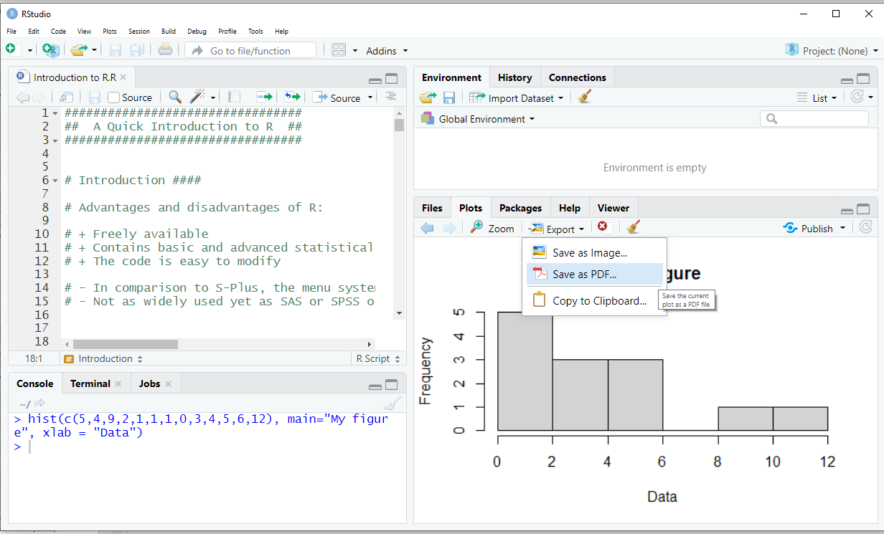
Overviewing files and results in R
3. How can I export figures?
Figures generated in the “Plots” window can easily be exported to high-quality figures into a file (e.g. “.jpg” or “.pdf”). Click “export” and choose one of the options.
Again, unless you are completely satistfied with your figure and need it for a report, there is not really a need to do this (because you can always create it again using your script).

Slide 31
Overviewing files and results in R
4. How can I save R scripts?
As a reminder (see slide 17), you can save R code in R scripts (files with extension .R) using “File” > “Save as” or by clicking the “save” icon above the Editor window.
As long as your project is still work in progress, it often makes more sense to save your scripts (= your analyses), rather than your results ( = the objects in your workspace) or figures. This is because it is quick and easy to run a script anytime again, and modify it as needed.

Slide 32
Overviewing files and results in R
4. How can I save R scripts?
As a reminder (see slide 17), you can save R code in R scripts (files with extension .R) using “File” > “Save as” or by clicking the “save” icon above the Editor window.
In fact, your script contains an archive of all your analyses! If you organize it well, it will be easy for you to remember what you did, and to re-run and improve the analyses whenever needed.
Notes:
Of course, this will save you BIG TIME

Slide 33
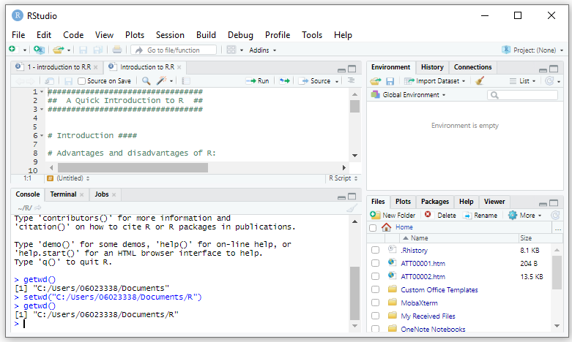
Overviewing files and results in R
5. How to find and change the current working directory?
As mentioned before (slide 13), R will always look for files in a specific working directory (= a specific physical space (folder) on your computer). So you will always get an error message when the file you want to work with does not exist in that directory, or when you don’t specify the correct path to this working directory.
So, you always need to be able to find and change your current working directory:
When you type «getwd()» (+ ENTER), Rstudio returns the current working directory
You can use the function «setwd()» to select another working directory.
When you then again execute «getwd()», you can see that the working directory has changed.

Slide 34
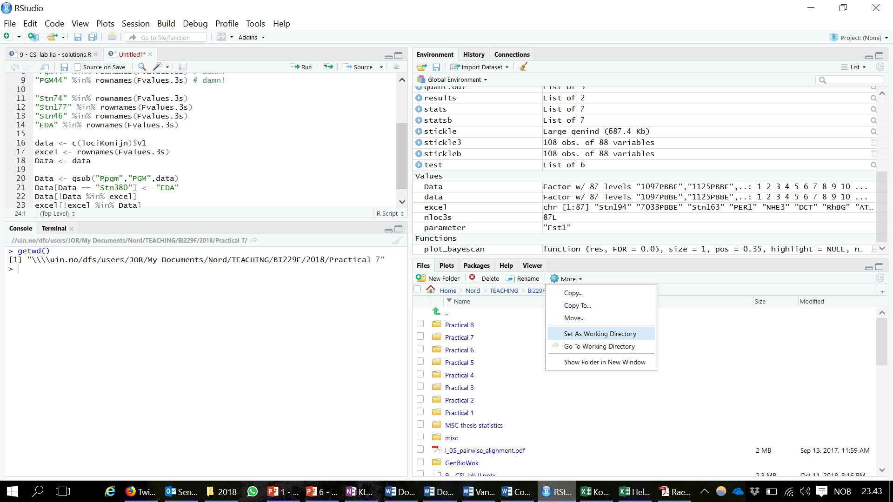
Overviewing files and results in R
5. How to find and change the current working directory?
So, you can always find the current working directory by using the command getwd():
> getwd()
[1] “C:/My Documents/Nord/TEACHING/BI229F/2018/“
… and you can always change the working directory by using the command setwd():
> setwd("C:/Users/Joost/Documents/MyCourse/")
However, if you are still unsure about your working directory, “MAGICAL little arrow” will safe you!

Slide 35
Overviewing files and results in R
5. How to find and change the current working directory?
So, you can always find the current working directory by using the command getwd():
> getwd()
[1] “C:/My Documents/Nord/TEACHING/BI229F/2018/“
… and you can always change the working directory by using the command setwd():
> setwd("C:/Users/Joost/Documents/MyCourse/")
However, if you are still unsure about your working directory, “MAGICAL little arrow” will safe you!
The “MAGICAL little arrow” contains a drop-down menu where you can set any folder from your file system as the working directory. It can also guide you back to your current working directory.

Slide 36
R packages («libraries»)
An R package or R library is a collection of functions.
For instance, the «base» package contains all basic commands (mean, sd, hist, ...). The «base» package is already embedded in R, and its functions can be readily used.
There are also many specialised packages. For instance, the package «vegan» contains commands specific for the analyses of communities for the field of community ecology. Such specialised packages first needs to be downloaded, installed and activated before the functions can be used.
Which packages you need varies between courses/disciplines (ecology, molecular biology, genetics, genomics, statistics, …)
Task: go to https://cran.uib.no > Packages > CRAN task views to get an overview of packages which are relevant for a specific field. Browse the topics/disciplines in biology (e.g. environmetrics, genetics, phylogenetics). There are many useful packages!

Slide 37
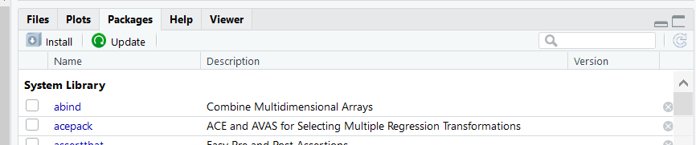
R packages («libraries»)
How to install and to launch a package?
R is an «open source platform», which means that many users of R share the commands and functions they have created with the rest of the R community via «CRAN» (https://cran.r-project.org). This is done in the form of packages designated to specific types of analyses. These packages are easily downloaded and installed in Rstudio (click « Install » in the package window).
Alternatively, you can download and install a specific package using the function install.packages(), as shown here for the package «lattice»:
> install.packages(c(«lattice"))
Finally, to activate the package, use the function library()
> library(«lattice")

Slide 38
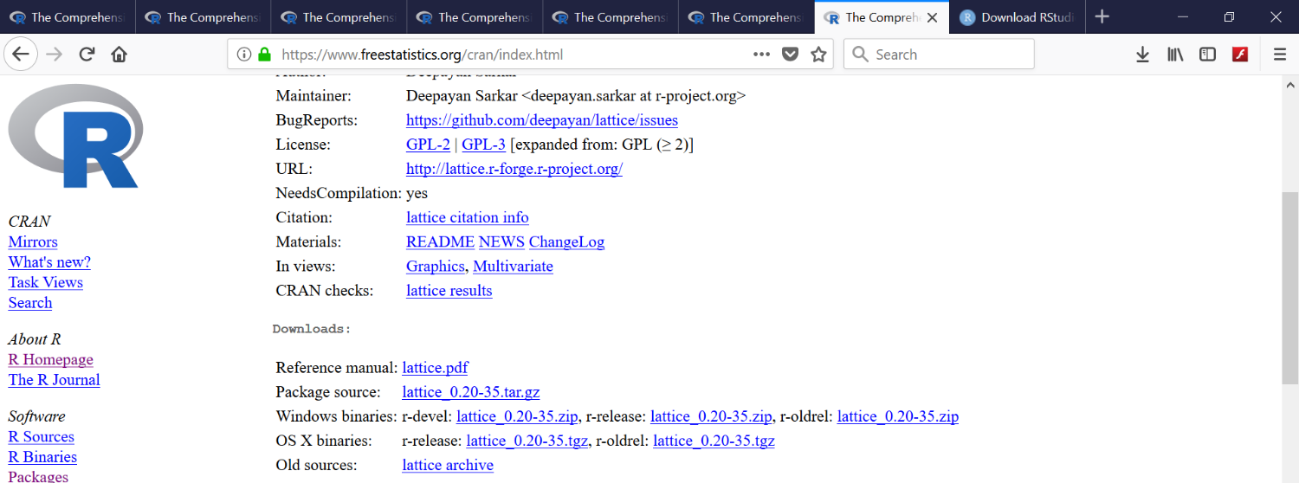
R packages («libraries»)
It is always possible to install a package (e.g. package «lattice») manually:
Find the package on CRAN (https://cran.uib.no/)
Click on «Downloads» and download 3 files:
Reference manual: Lattice.pdf
Package source: Lattice_x.xx-xx.tar.gz (compressed but not compiled)
Windows/OS X binary: r-release: Lattice_x.xx-xx.zip or .tgz (compressed + compiled)
1
3
2

Slide 39
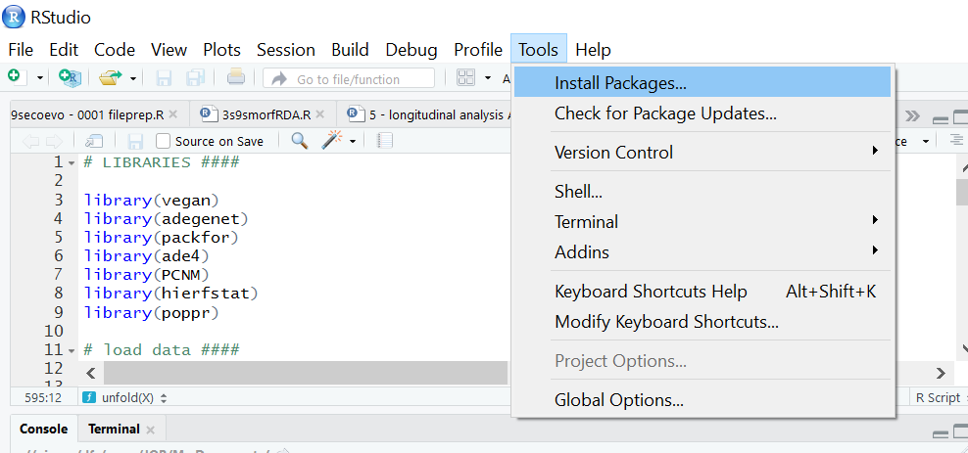
R packages («libraries»)
It is always possible to install a package (e.g. package «lattice») manually:
Rstudio > Tools > Install packages > Install from:
Repository (CRAN)
Package archive file (.zip; .tar.gz)
Choose option (b)
Install the package from the « .zip » or « .tar.gz » file

Slide 40
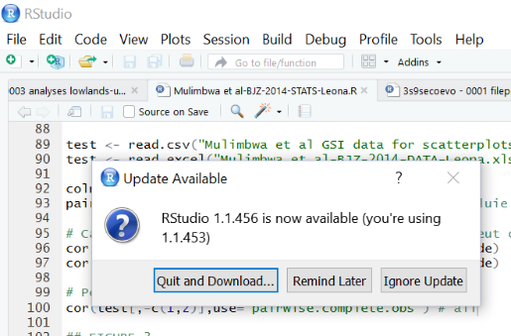
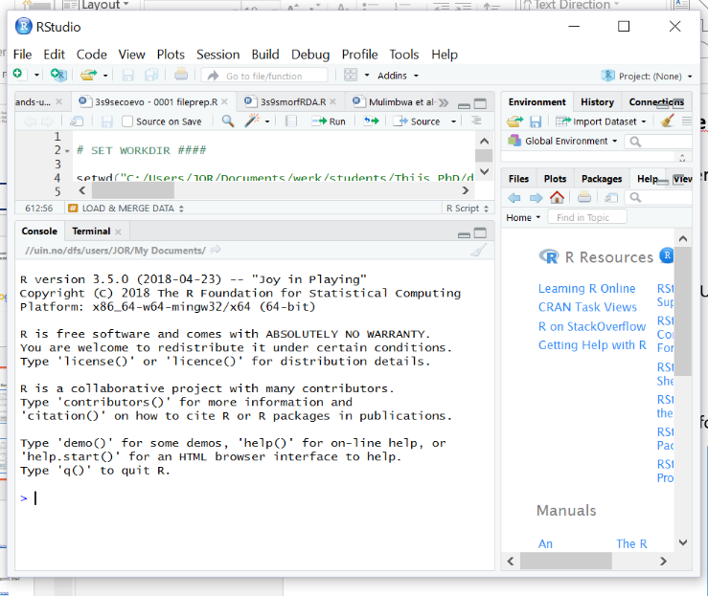
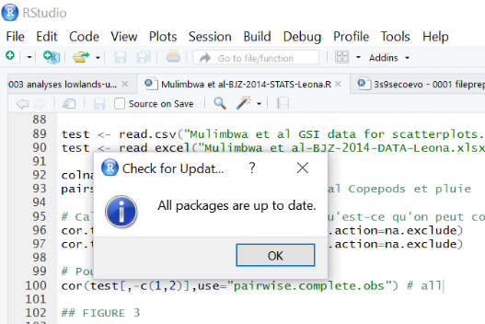
How to maintain R and Rstudio?
Make sure to regularly update R, Rstudio and the various packages with the most recent version. How to check the version?
2) For the version of Rstudio, check:
Rstudio > Help > Check for Updates
1) The version and release date of R is shown in the R console at start-up:
3) For the version of the packages, check:
Rstudio > Tools > Check for Package Updates

Slide 41
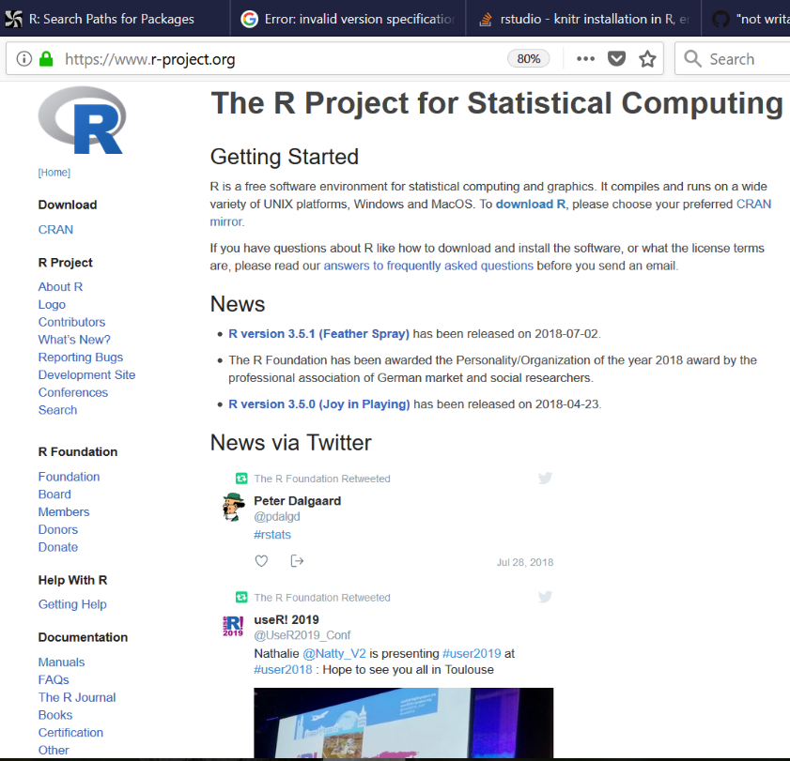
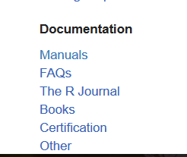
Finding help with R
Online help and documentation (www.r-project.org)

Slide 42
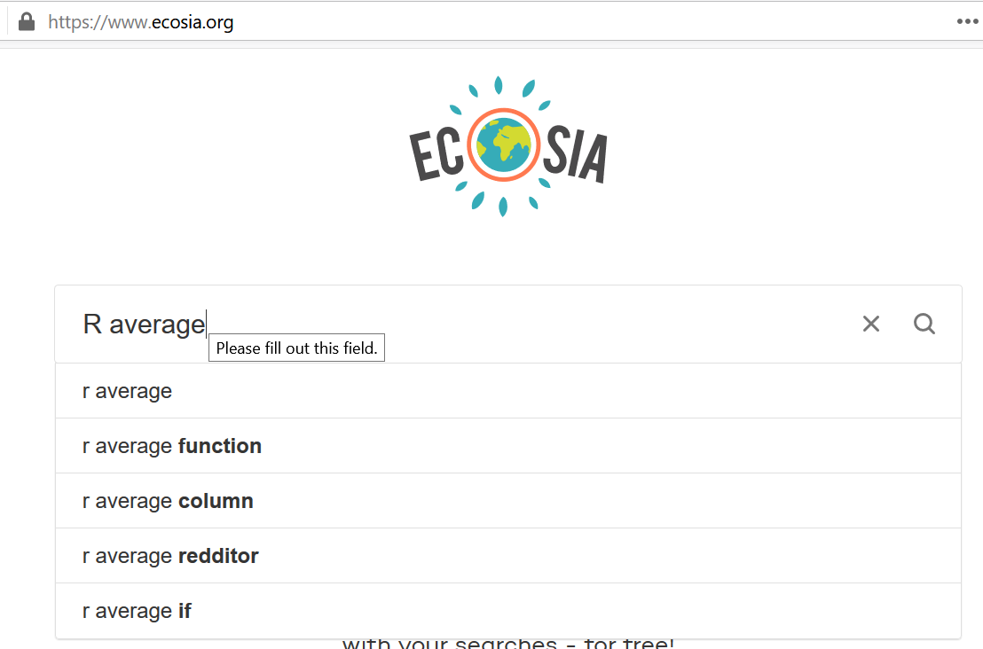
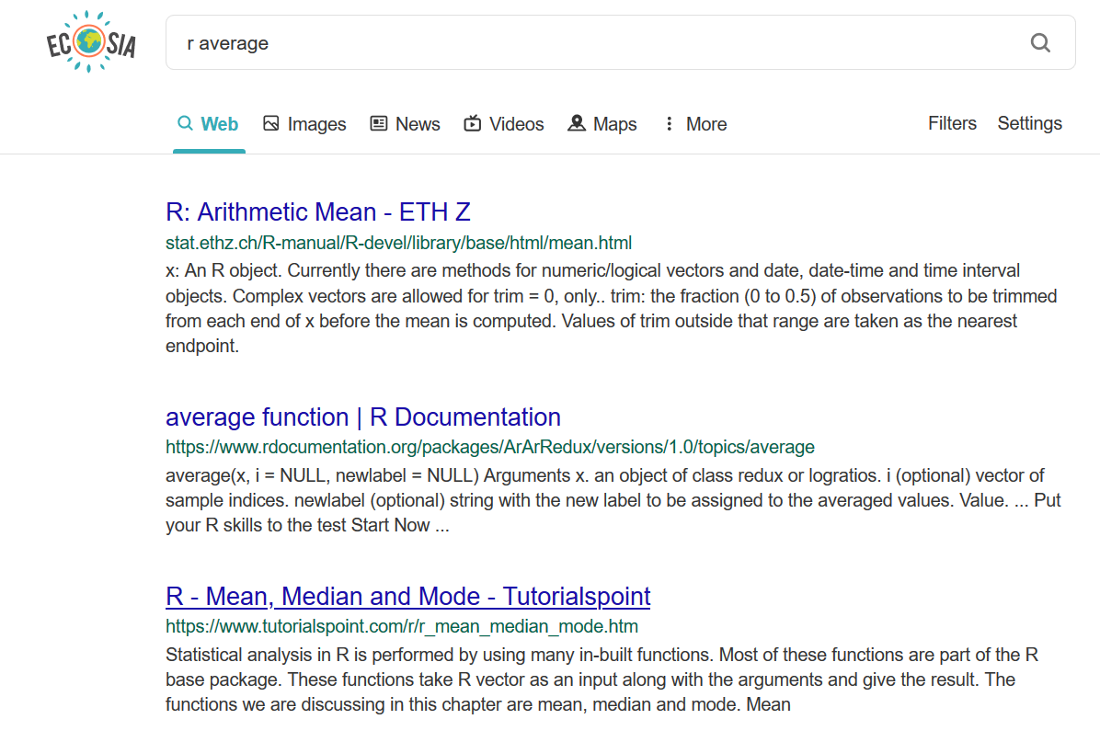
Finding help with R
2) Search engines such as Ecosia (www.ecosia.org) or Google (www.google.com). First type «R», and then add search terms. This could be the function for which you need help, an error message you don’t understand, or a description of what you want to achieve.
Ecosia plants trees every time you do a search ☺
Note that search engines often give good suggestions to complete your search!

Slide 43
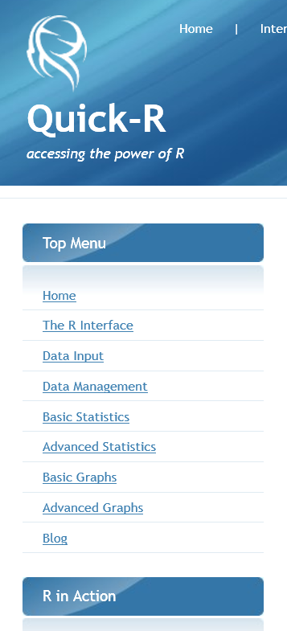
Finding help with R
3) Some specialized websites:
http://stackoverflow.com
https://stats.stackexchange.com
http://www.statmethods.net
http://www.statmethods.net/

Slide 44
Finding help with R
4) People near you
The R community is large and expanding... including at university. But, you have to follow some rules:
You are most likely to get good help with your R problem if you provide a reproducible example. A reproducible example allows someone else to recreate your problem by just copying and pasting R code.
There are four things you need to include to make your example reproducible: required packages, data, code, and a description of your R environment.
https://stackoverflow.com/questions/5963269/how-to-make-a-great-r-reproducible-example
Be patient, be polite, acknowledge

Slide 45
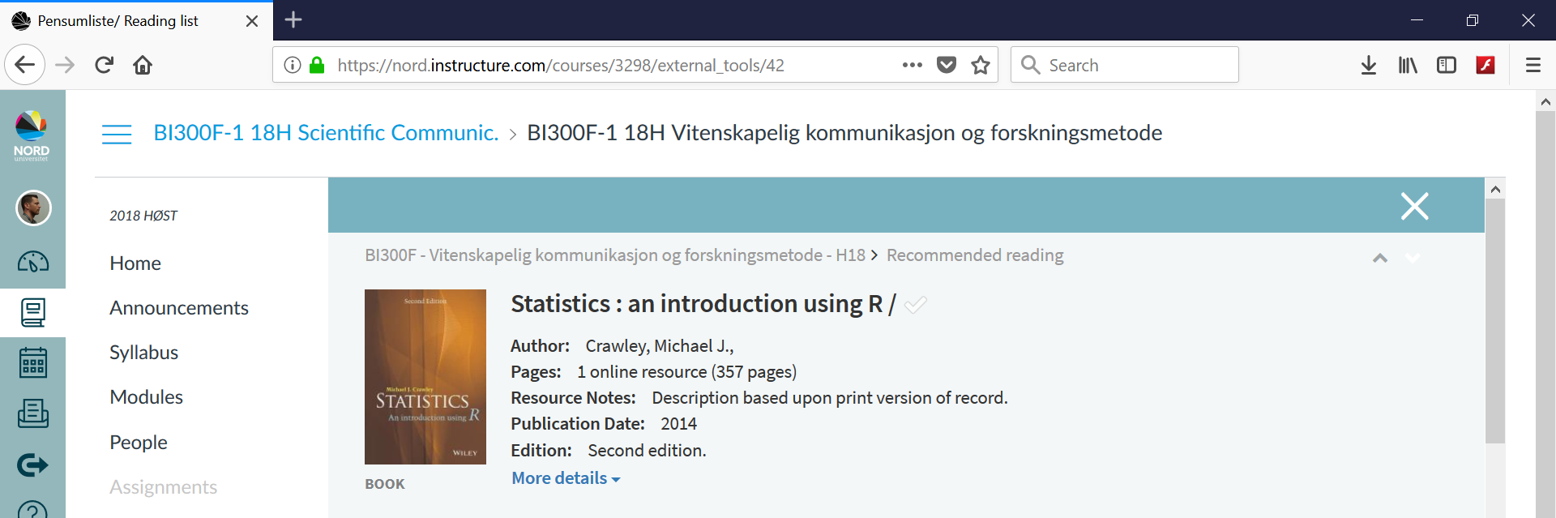
Finding help with R
5) Recommended reading
Michael J. Crawley (2014) Statistics: an Introduction using R. Wiley-Blackwell

Slide 46
Good luck with R!

